Slide 1
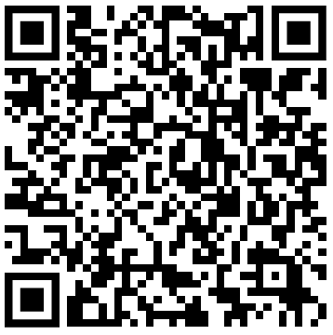
NLP Track 2/3:
Transformer
https://forms.gle/YG9TtSbimF2bhiUR8
Attendance
Relevant links are inside the form
We will start at 7.05

Slide 2
What are we learning?
Transformers
Huggingface
Use cases

Slide 3
How are we doing this?
The big picture - to build some intuition
The math - key formulae
Practice - using hugging face and fine tuning

Slide 4
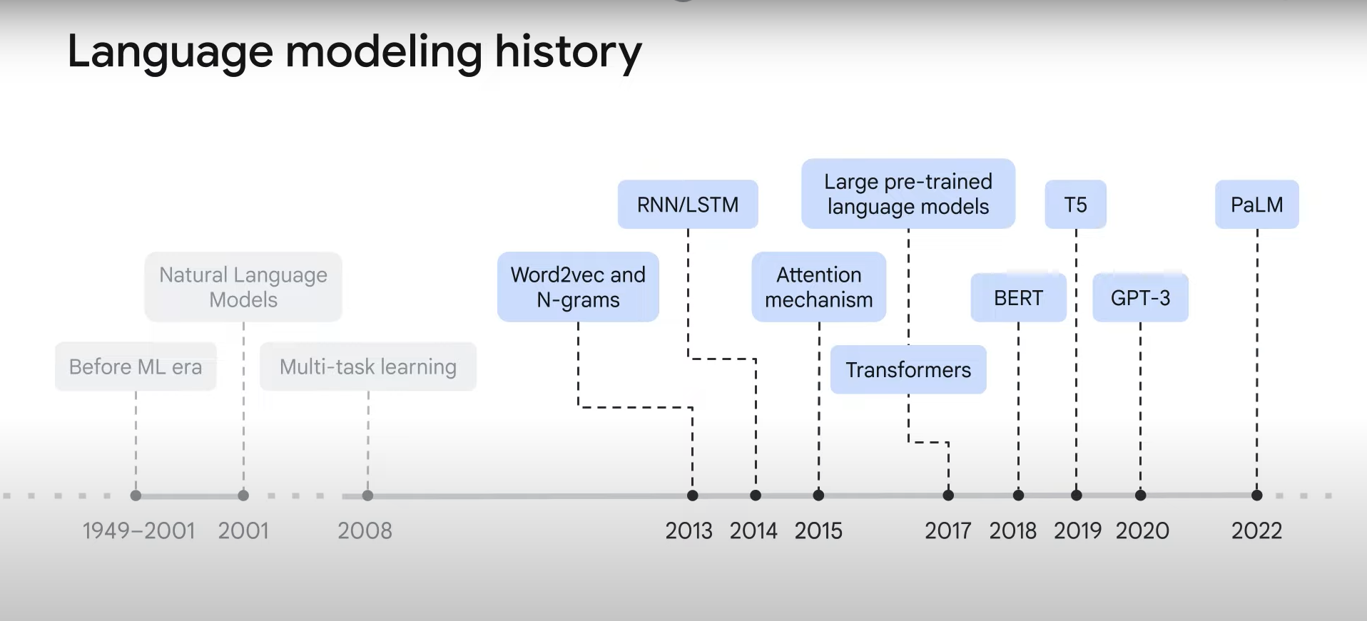
The motivation, why transformers?

Slide 5
Where can we find them?
Chat GPT/ GPT-4
Google Search (BERT (which we will be using later), Gemini)
Alpha fold (Protein folding) (google deepmind)

Slide 6
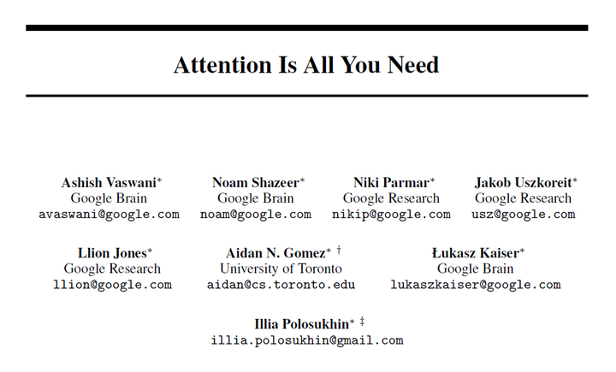

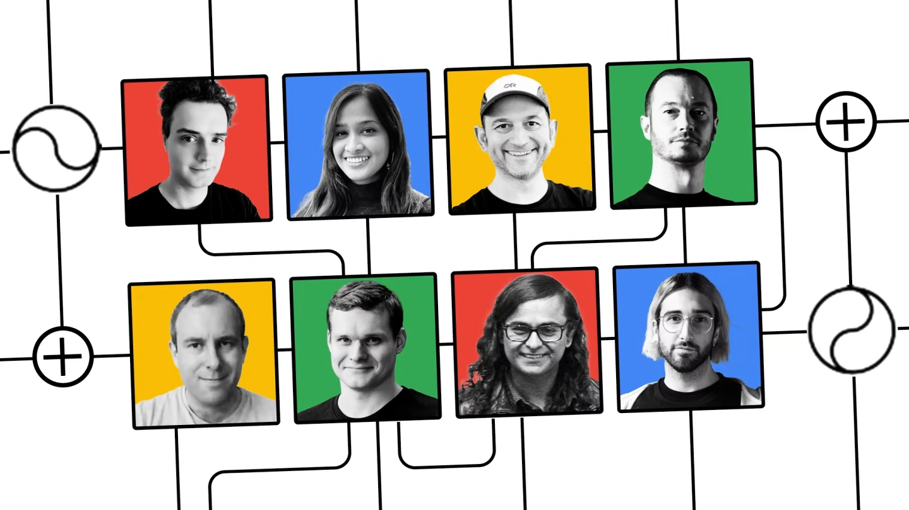
What is a transformer ->
Notes:
https://www.ft.com/__origami/service/image/v2/images/raw/ftcms%3A373bcacb-c6b6-46d0-b31a-95f6675f63b6?source=next-article&fit=scale-down&quality=highest&width=1440&dpr=1

Slide 7
What is a transformer ->
It's basically a black box, we will shed some light at the architecture but there are still things that are unknown about transformers

Slide 8
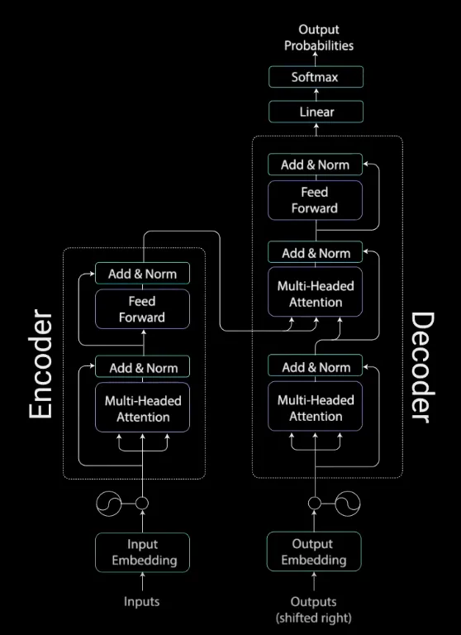
<- What is a transformer

Slide 9
What made the transformers Such a powerful tool!
Attention mechanisms 🔬
Self supervised learning 🏋️
Transfer learning and fine tuning 🪛

Slide 10
Attention mechanisms 🔬

Slide 11
What is a transformer ->

Slide 12
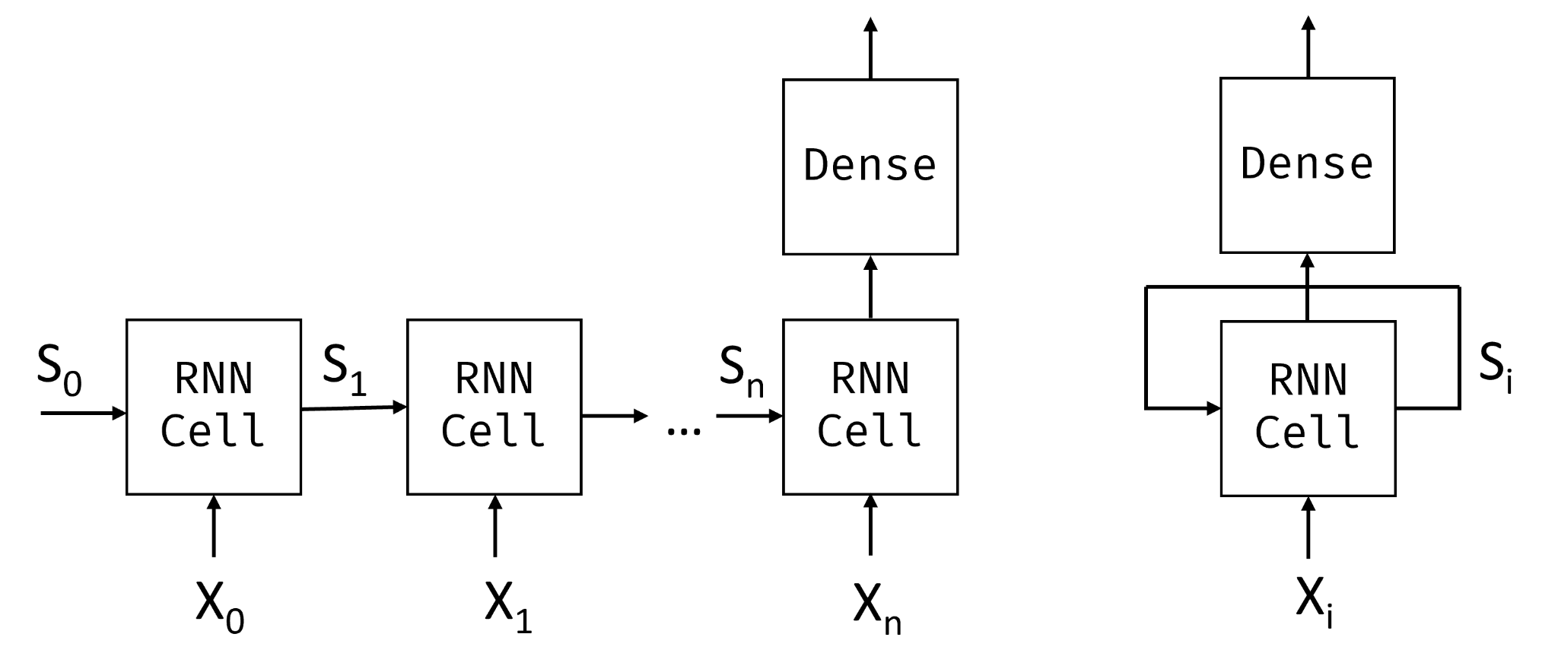
Recap
Embeddings - word to numbers (computers sadly can't understand words)
RNN - Recurrent neural networks

Slide 13
Attention mechanism, Why?
Biggest issue with RNNs is that they forget initial parts of the sentence as more words are fed in (vanishing gradient)
Attention attempts to solve this by extracting outputs from each iteration and feeding it into the attention mechanism, which adds in corresponding weights for the outputs before decoding it
Attention gave rich contextual representation which helped the decoders decode text better
removed the RNN completely -> purely attention based network called a transformer

Slide 14
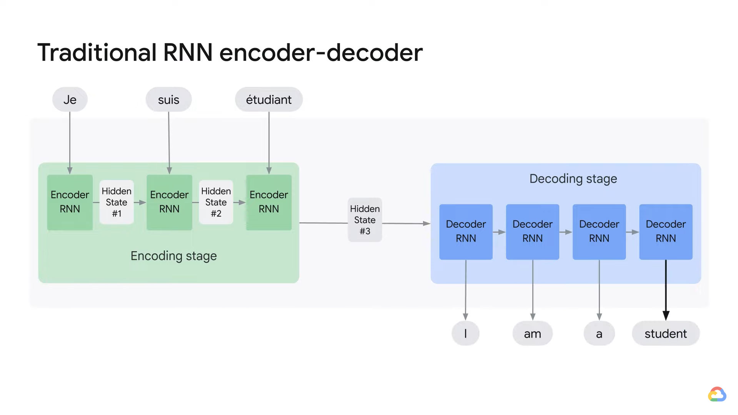
Telephone game
Notes:
Transformer Models and BERT Model: Overview (youtube.com)

Slide 15
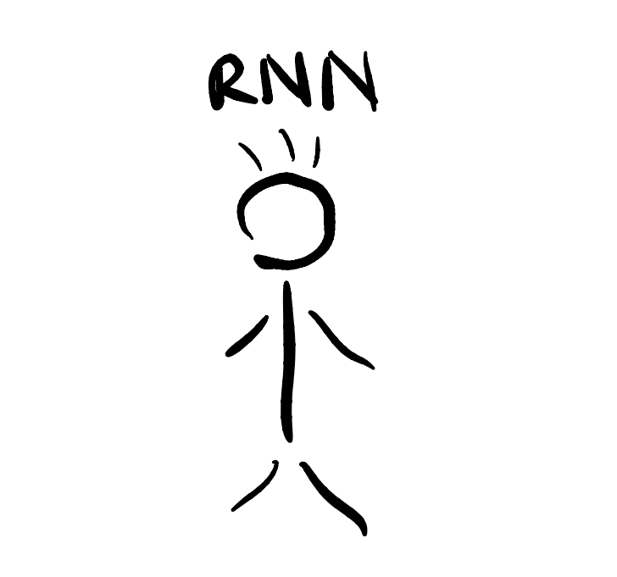

Slide 16
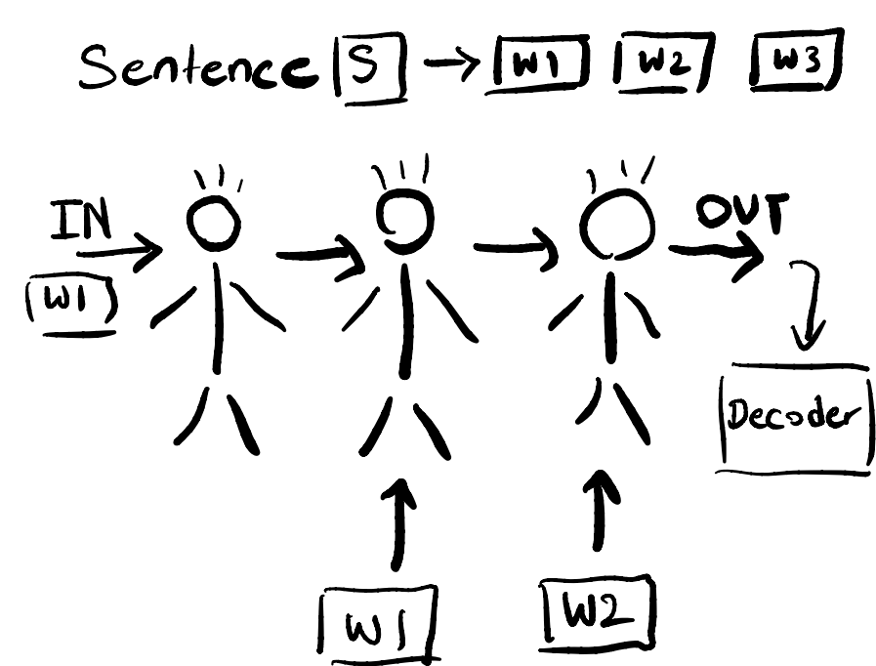

Slide 17
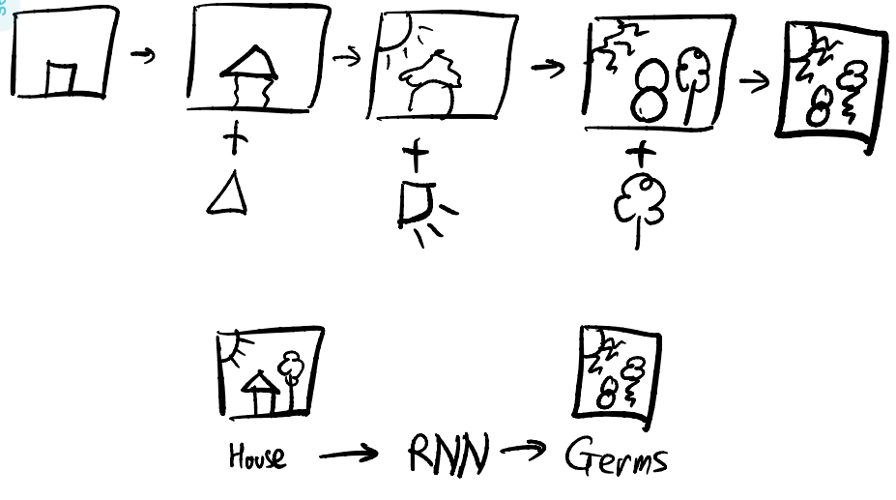

Slide 18
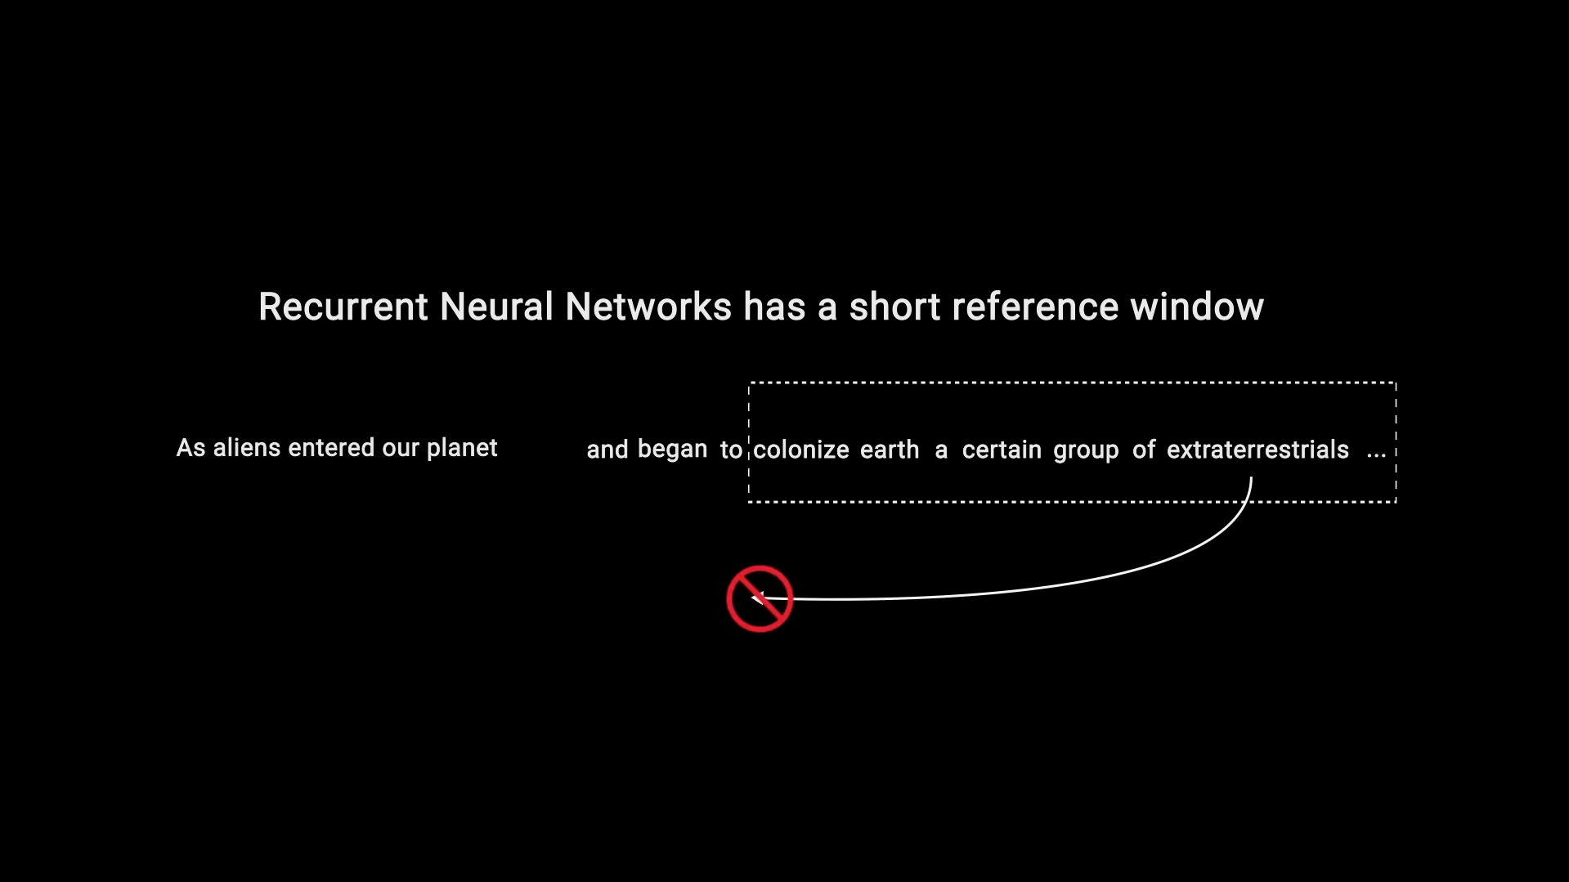

Slide 20
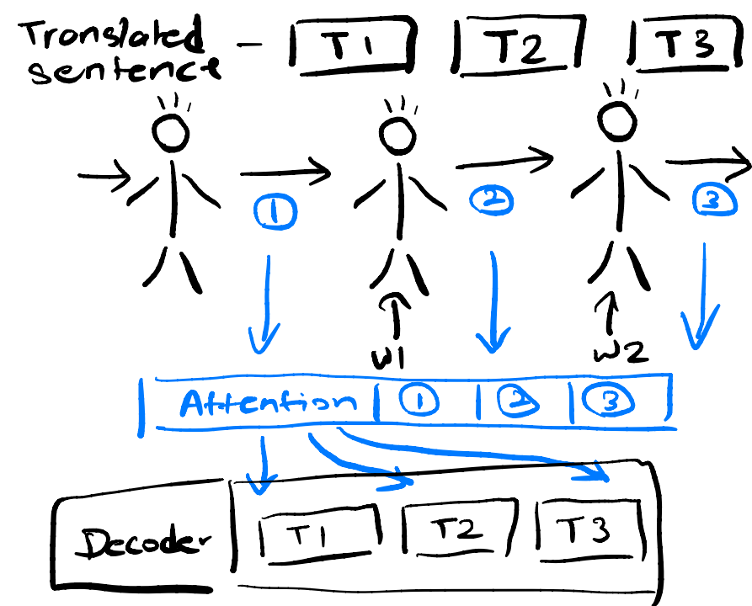

Slide 21
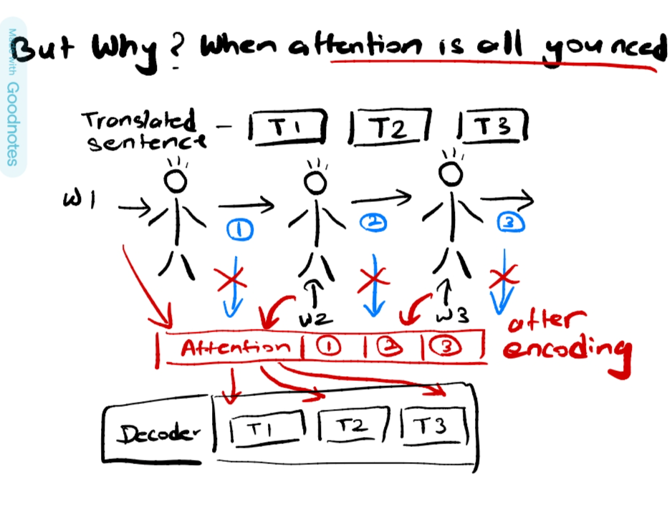

Slide 22
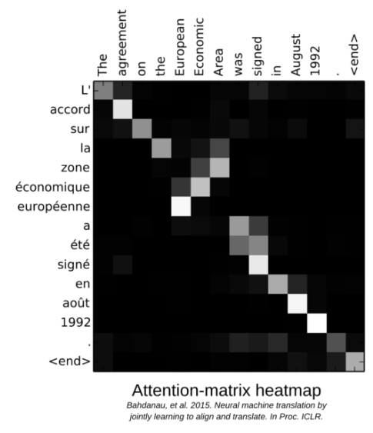
Attention mechanism
on a translation task
Notes:
Hands-On NLP with Transformers and Huggingface: Part 1, Leandro von Werra (ML Engineer@HuggingFace) (youtube.com)

Slide 23
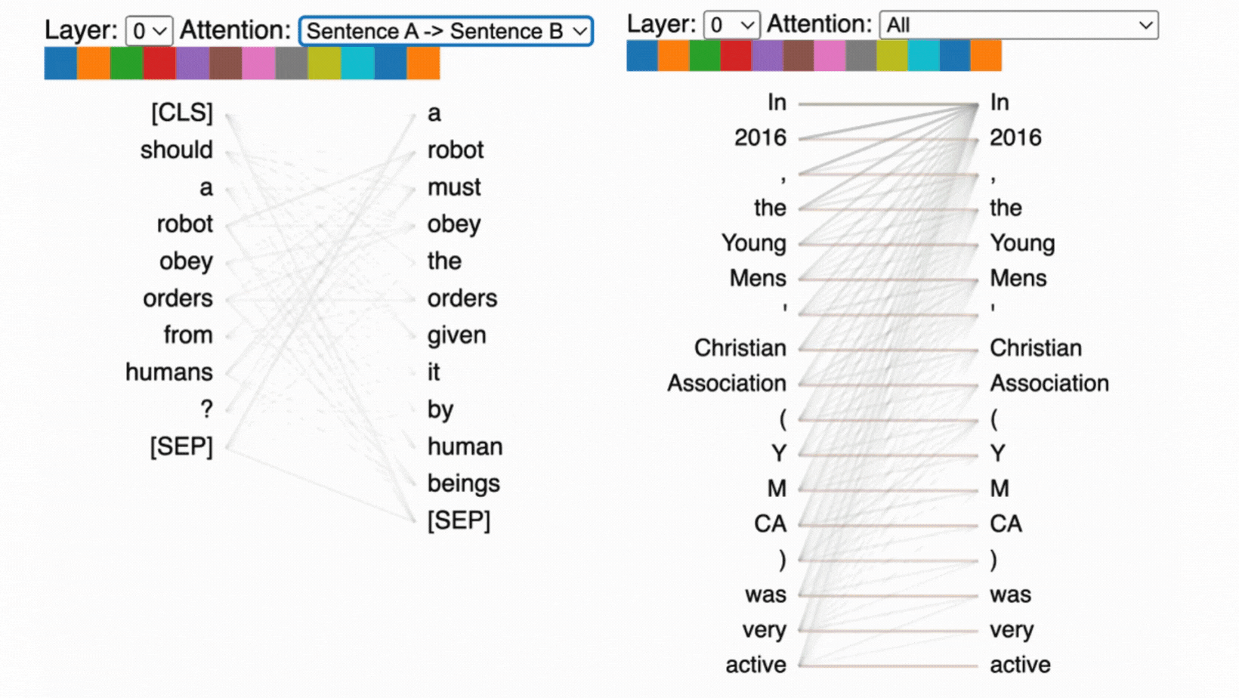
Notes:
Explainable AI: Visualizing Attention in Transformers - Comet

Slide 24
Attention is all you need
Notes:
https://arxiv.org/abs/1706.03762

Slide 25
What is a transformer ->
Notes:
Illustrated Guide to Transformers- Step by Step Explanation | by Michael Phi | Towards Data Science

Slide 26
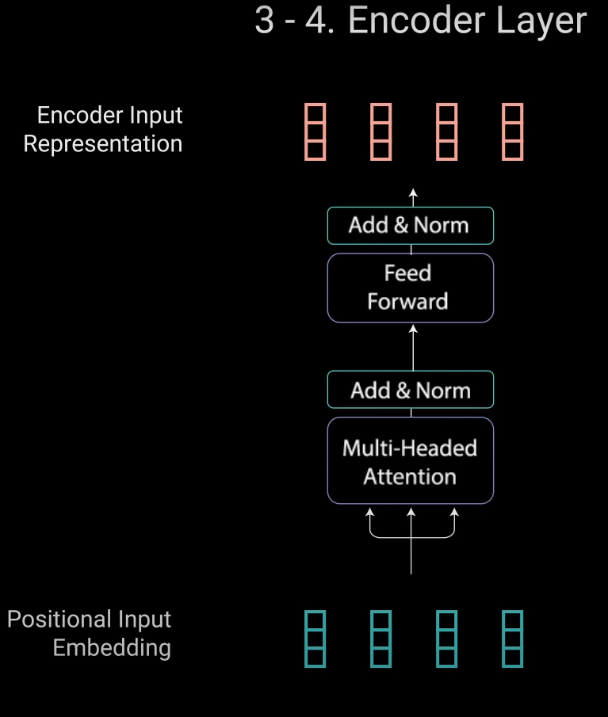
What is a transformer -> 1. Encoder
The encoder has multiple components
Input embedding
Multi Headed attention
Notes:
Illustrated Guide to Transformers- Step by Step Explanation | by Michael Phi | Towards Data Science

Slide 27
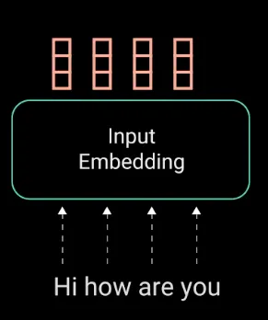
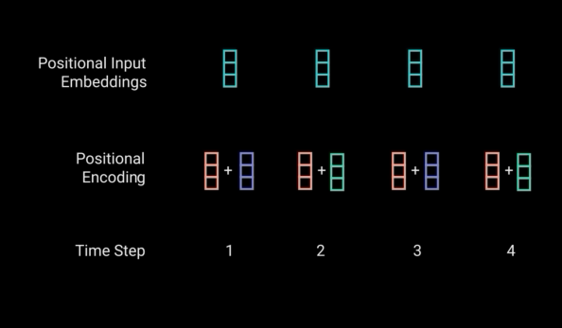
What is a transformer -> 1.1 Embeddings
Input embedding is word to vector, we usually use word to vec but this is trained along with the model
Notes:
Illustrated Guide to Transformers- Step by Step Explanation | by Michael Phi | Towards Data Science

Slide 28
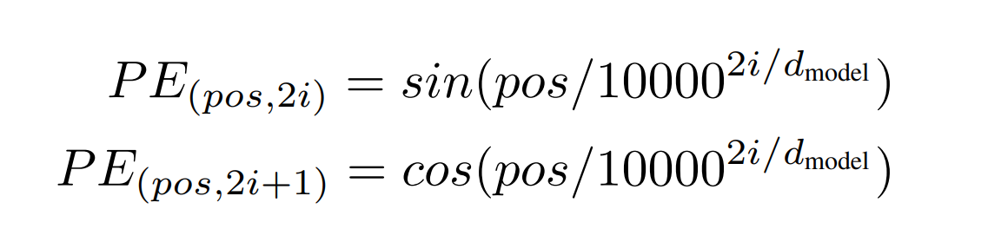
Math -> Positional encoding
Notes:
https://arxiv.org/abs/1706.03762

Slide 29
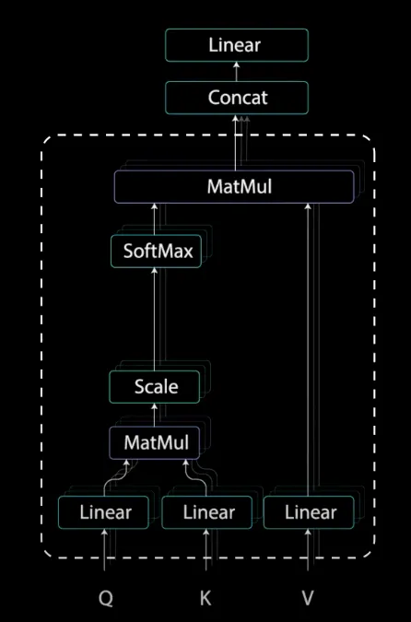
What is a transformer -> 1.2 Multi-headed attention
Multi-Headed Attention
Applies a mechanism called self-attention.
Allows the models to associate each word in the input, to other words.
It’s also possible that the model learns that words structured in this pattern are typically a question so respond appropriately.
Notes:
Illustrated Guide to Transformers Neural Network: A step by step explanation (youtube.com)
Transformers - Attention is all you need Detailed Architecture Intuition | Medium
Illustrated Guide to Transformers- Step by Step Explanation | by Michael Phi | Towards Data Science
The Illustrated Transformer – Jay Alammar – Visualizing machine learning one concept at a time. (jalammar.github.io)

Slide 30
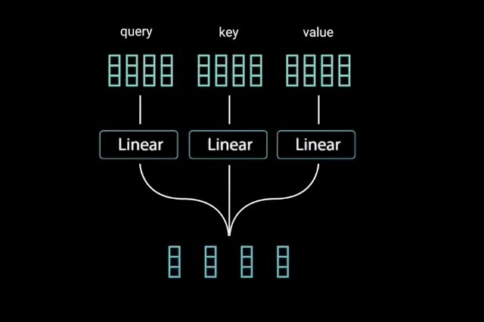
What is a transformer -> 1.2.1 self-attention.
Idea of Query, Key and Value.
Stack exchange
The query key and value concept come from retrieval systems.when you type a query to search for some video on Youtube, the search engine will map your query against a set of keys (video title, description etc.) associated with candidate videos in the database, then present you the best matched videos (values).
neural networks - What exactly are keys, queries, and values in attention mechanisms? - Cross Validated (stackexchange.com)
Notes:
Illustrated Guide to Transformers Neural Network: A step by step explanation (youtube.com)
Transformers - Attention is all you need Detailed Architecture Intuition | Medium
Illustrated Guide to Transformers- Step by Step Explanation | by Michael Phi | Towards Data Science
The Illustrated Transformer – Jay Alammar – Visualizing machine learning one concept at a time. (jalammar.github.io)

Slide 31
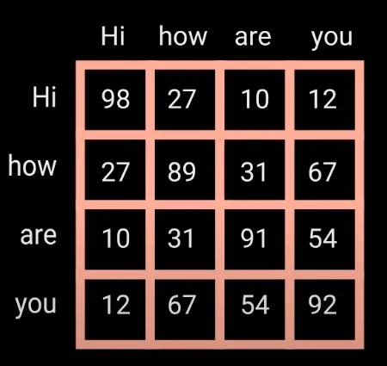
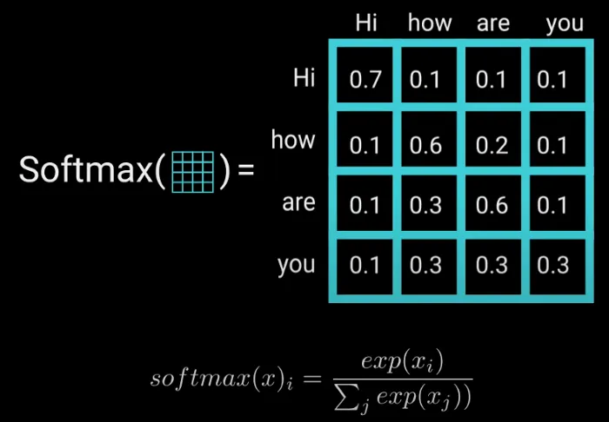
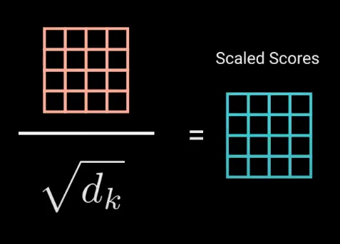
What is a transformer -> 1.2.1 self-attention.
->
->
How does the size change, how they train inference
Notes:
Illustrated Guide to Transformers Neural Network: A step by step explanation (youtube.com)
Transformers - Attention is all you need Detailed Architecture Intuition | Medium
Illustrated Guide to Transformers- Step by Step Explanation | by Michael Phi | Towards Data Science
The Illustrated Transformer – Jay Alammar – Visualizing machine learning one concept at a time. (jalammar.github.io)

Slide 32
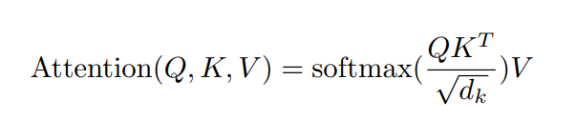
Math -> Attention
Notes:
https://arxiv.org/abs/1706.03762

Slide 33
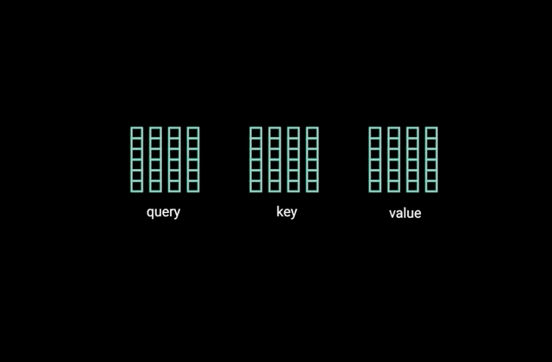
What is a transformer -> 1.2.1 Multi-headed attention
query, key, and value into N vectors before applying self-attention.
Notes:
Illustrated Guide to Transformers Neural Network: A step by step explanation (youtube.com)
Transformers - Attention is all you need Detailed Architecture Intuition | Medium
Illustrated Guide to Transformers- Step by Step Explanation | by Michael Phi | Towards Data Science
The Illustrated Transformer – Jay Alammar – Visualizing machine learning one concept at a time. (jalammar.github.io)

Slide 34
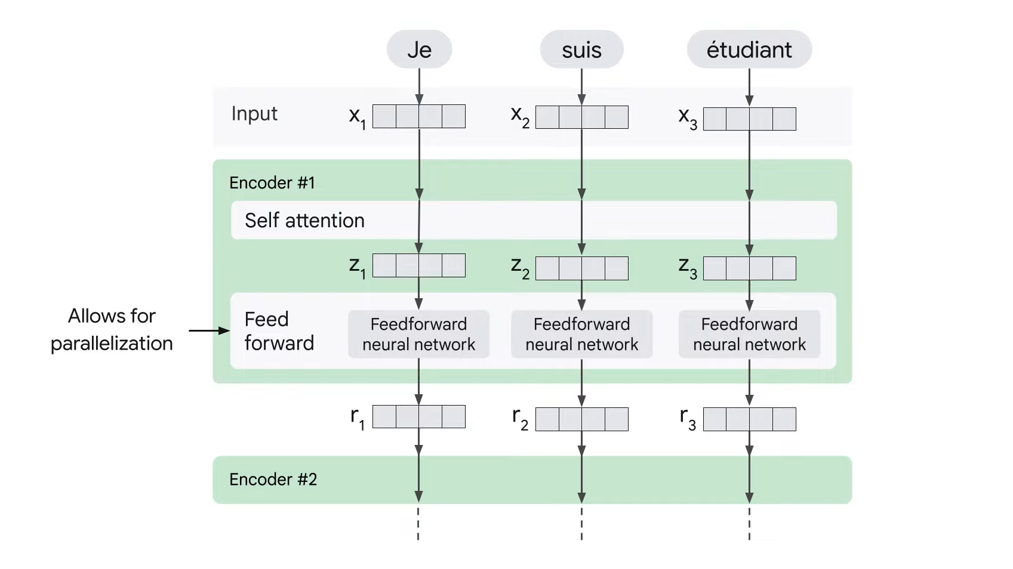
What is a transformer -> 1.3 Feed forward Neural Network
query, key, and value into N vectors before applying self-attention.
Notes:
Illustrated Guide to Transformers Neural Network: A step by step explanation (youtube.com)
Transformers - Attention is all you need Detailed Architecture Intuition | Medium
Illustrated Guide to Transformers- Step by Step Explanation | by Michael Phi | Towards Data Science
The Illustrated Transformer – Jay Alammar – Visualizing machine learning one concept at a time. (jalammar.github.io)

Slide 35
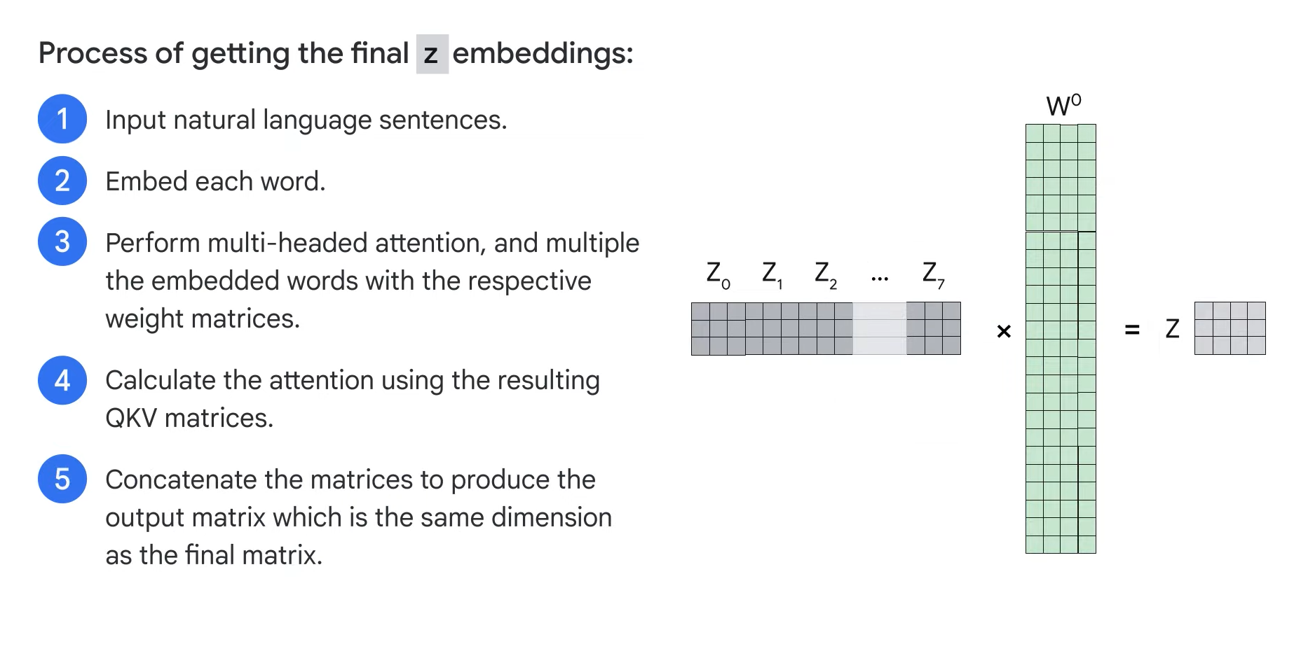
To Sum up ->
Notes:
Transformer Models and BERT Model: Overview (youtube.com)

Slide 36
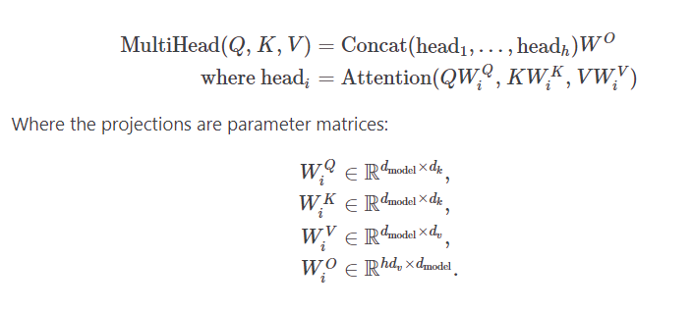
Math -> Multi-headed attention

Slide 37
Difference between attention and self-attention ->
Attention - allows the model to focus on different parts of the input sequence
Self Attention - relationship between elements in the sequence is important, think arranging objects in 3D (or higher dimension) based on their features.

Slide 38
Multi-Headed attention and CNN -> whats common
CNNs use convolutional layers to apply filters across local regions of the input data (e.g., an image or a sequence), capturing local patterns such as edges in images or n-gram patterns in text.
Multi-Headed Attention, particularly in the context of Transformers, allows the model to focus on different parts of the input globally and capture relationships between distant elements in the sequence.

Slide 39
2.Self supervised learning 🏋️

Slide 40
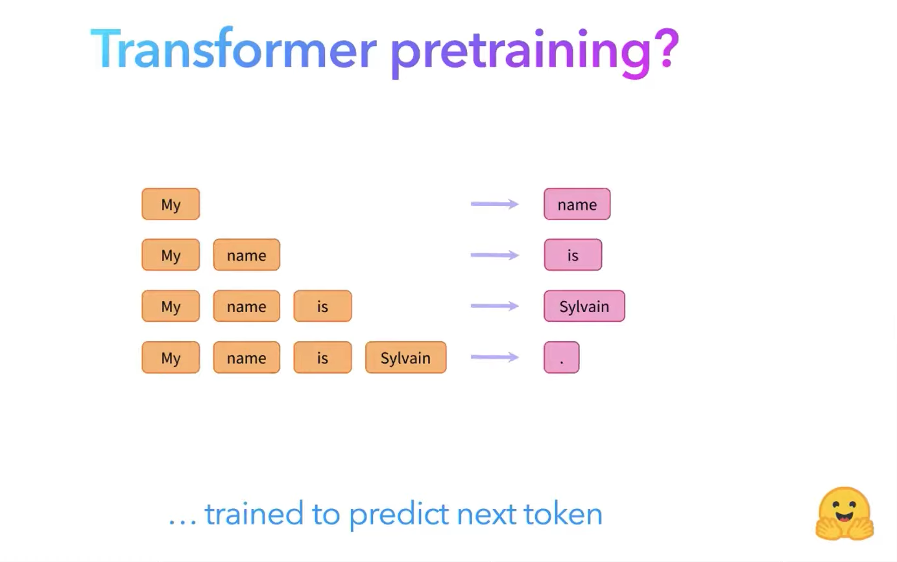
Notes:
Credits - Hands-On NLP with Transformers and Huggingface: Part 1, Leandro von Werra (ML Engineer@HuggingFace) (youtube.com)

Slide 41
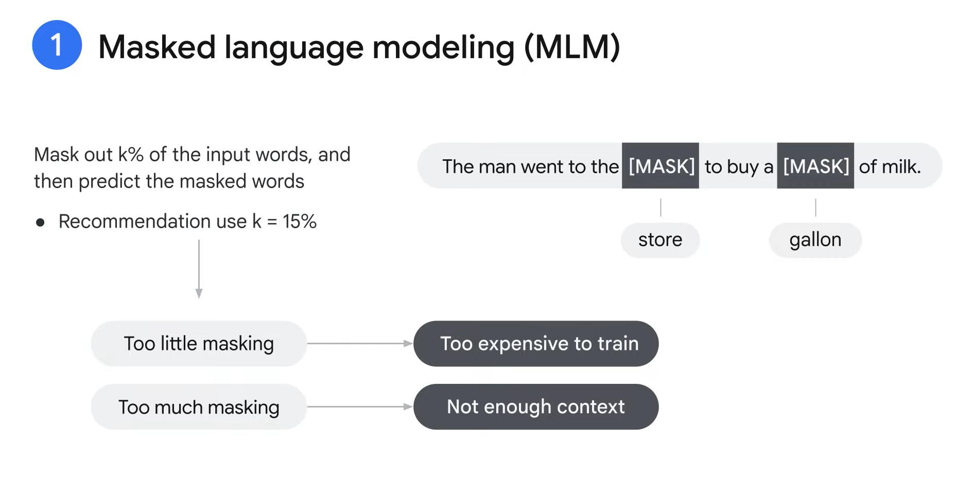
Self supervised learning -> what is it?
(what is supervised learning, requires humans, this can be automated, ie the input is in itself the label.)
Notes:
Transformer Models and BERT Model: Overview (youtube.com)

Slide 42
Self supervised learning -> why is it better?
what is supervised learning, requires humans -> more effort
Self-supervised learning this can be automated, ie the input is in itself the label

Slide 43
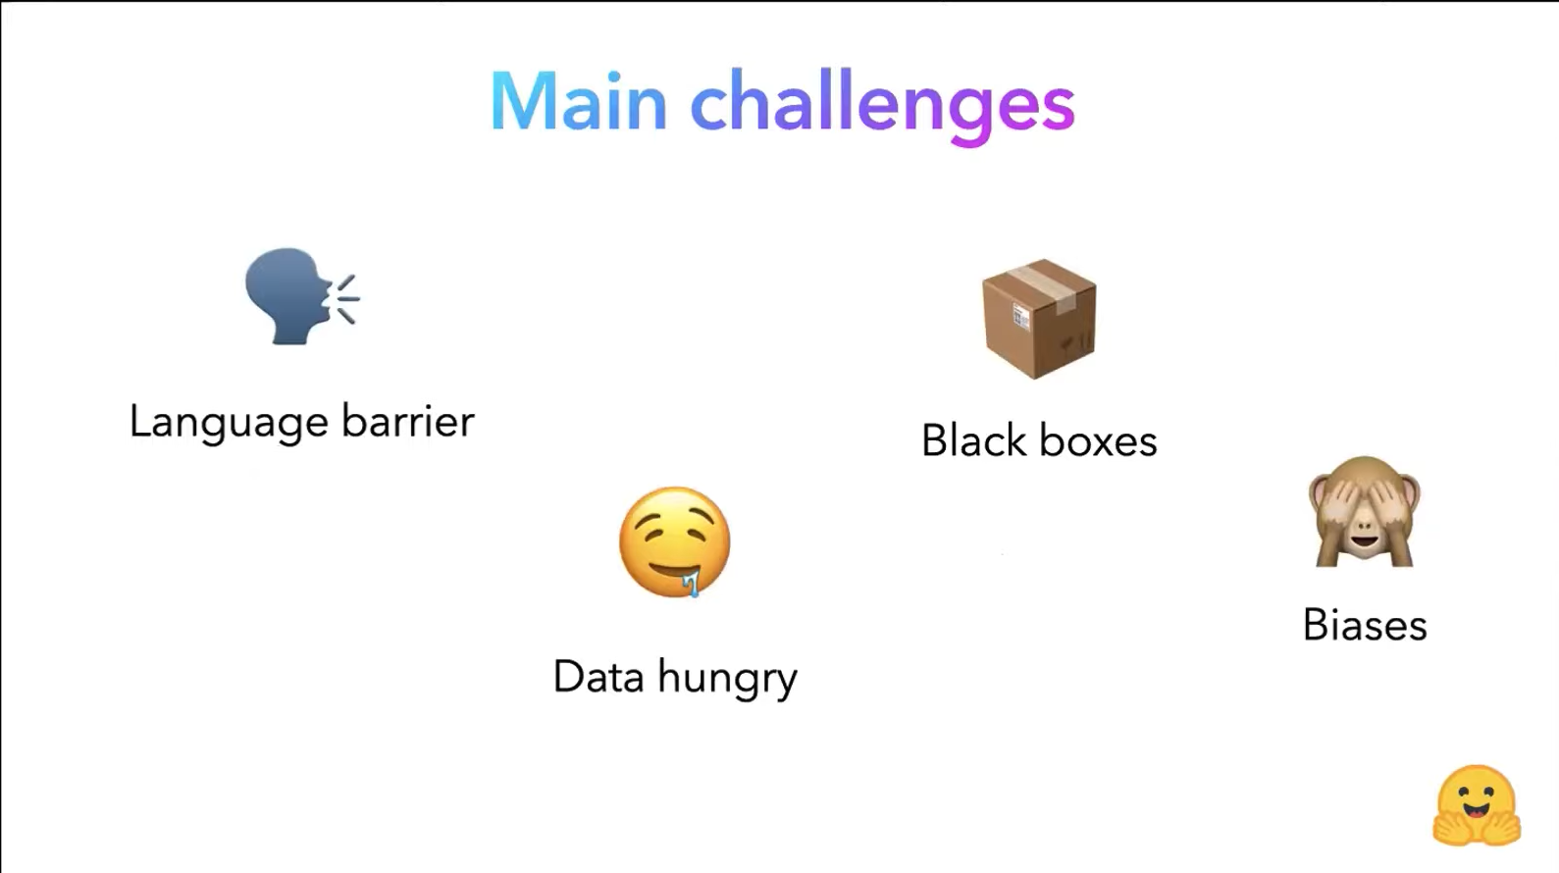
Notes:
Credits - Hands-On NLP with Transformers and Huggingface: Part 1, Leandro von Werra (ML Engineer@HuggingFace) (youtube.com)

Slide 44
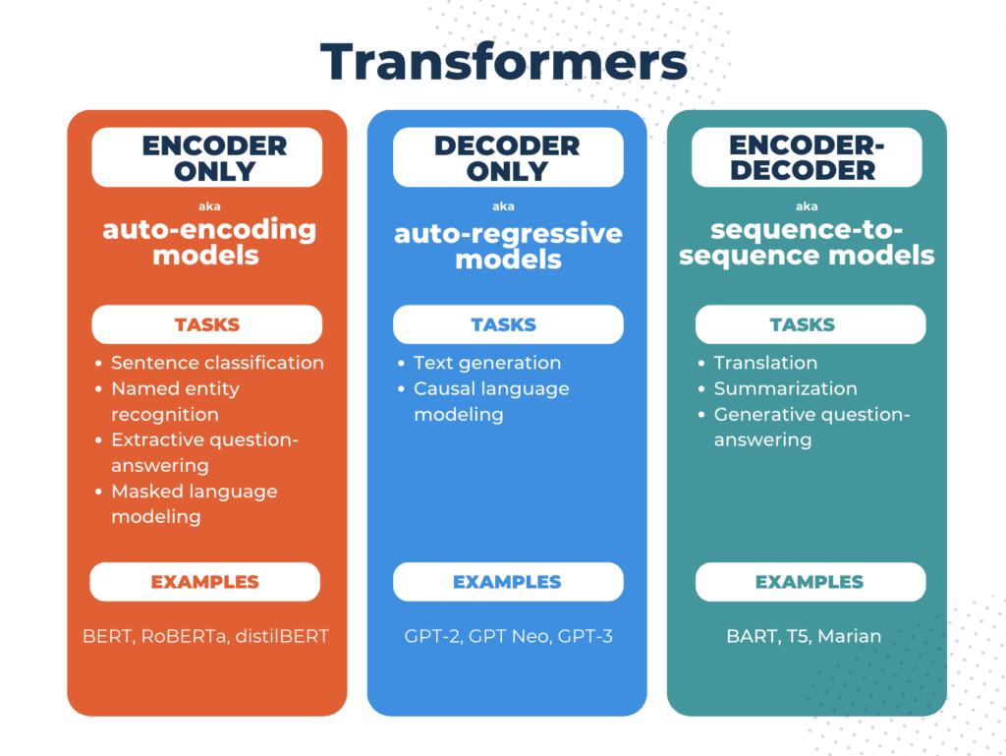
Notes:
https://www.comet.com/site/wp-content/uploads/2023/07/Screen-Shot-2023-07-11-at-9.48.50-PM-1024x769.png

Slide 45
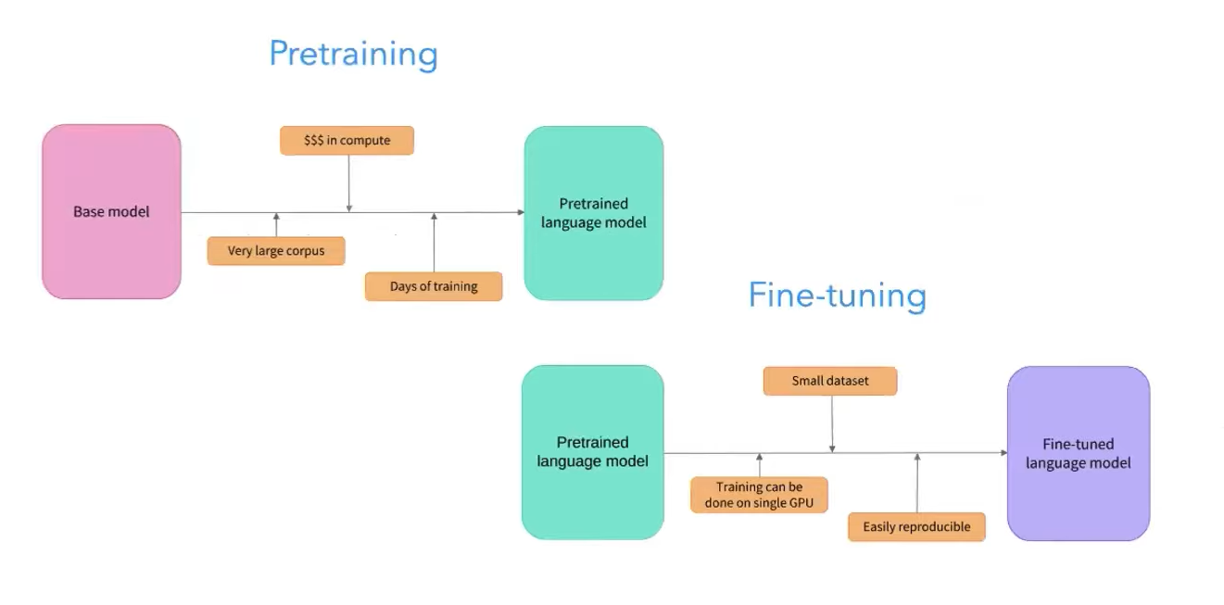
current paradigm
Notes:
Credits - Hands-On NLP with Transformers and Huggingface: Part 1, Leandro von Werra (ML Engineer@HuggingFace) (youtube.com)

Slide 46
3.Transfer learning and fine tuning 🪛

Slide 47
Hugging Face -> an introduction
Bad Documentation
Poor API calls
Many models that are altered versions of foundation models (confusing)

Slide 48
Hugging Face
🤗 Transformers (huggingface.co)
https://huggingface.co/docs/transformers/v4.37.2/index

Slide 49
Hugging Face -> Fine tuning
Fine-tune a pretrained model (huggingface.co)
https://huggingface.co/docs/transformers/v4.37.2/training

Slide 50
Hugging Face -> Fine tuning
Copy of training.ipynb - Colaboratory (google.com)
https://colab.research.google.com/drive/1PxloTxVSUTmz-sdZfOwC8XHFkaYfDIq2?authuser=1#scrollTo=YfSU3H9-k-8u

Slide 51




Transformer QR Codes
MLDA Handbook
https://docs.google.com/spreadsheets/d/1xPrLgY6E_iNN2R0jU0MEf8N75Xcn5FIM--ruNihjrqU/edit#gid=1925502567
LEARNOVA Playlist
https://www.youtube.com/playlist?list=PLXpIV63PRtvXM5I-6Fv9Z1s3tXV91n636
Quiz
https://forms.gle/wQtiAaubJUr47tLb9
Feedback https://forms.gle/Ww95EAAwGvUZSLYt7

